Slide 1
Flight Price
Optimal timing for airline ticket purchasing from the consumer’s perspective is challenging principally because buyers have insufficient information for reasoning about future price movements. In this project we simulate various models for computing expected future prices and classifying whether this is the best time to buy the ticket.

Slide 2
Pipeline Follows
Scrapping.
Load Dataset
EDA
Visualization
Data Cleaning
Scaling
Model Building
Save

Slide 3
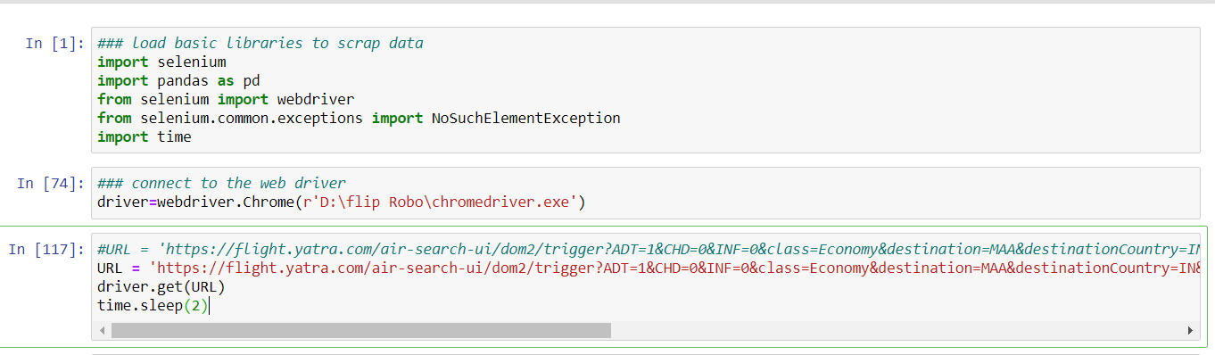
Scrap the data using Selenium

Slide 4
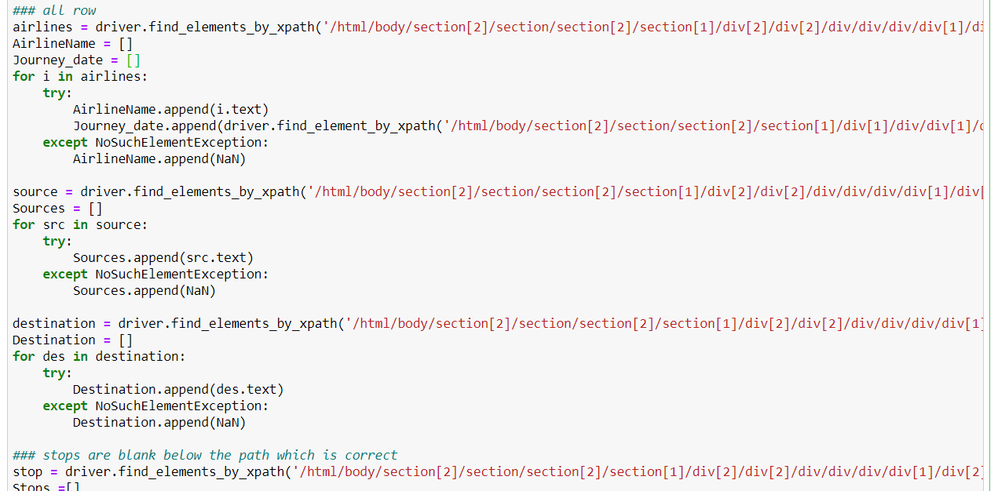
Scrapping And Storing in Variables/Array

Slide 5
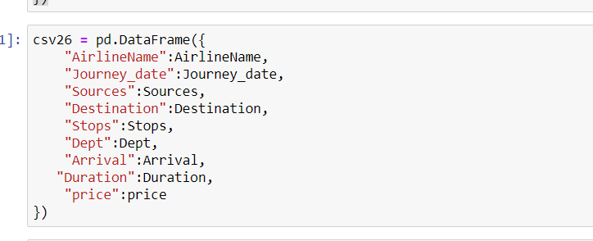

Save Into Csv format

Slide 6
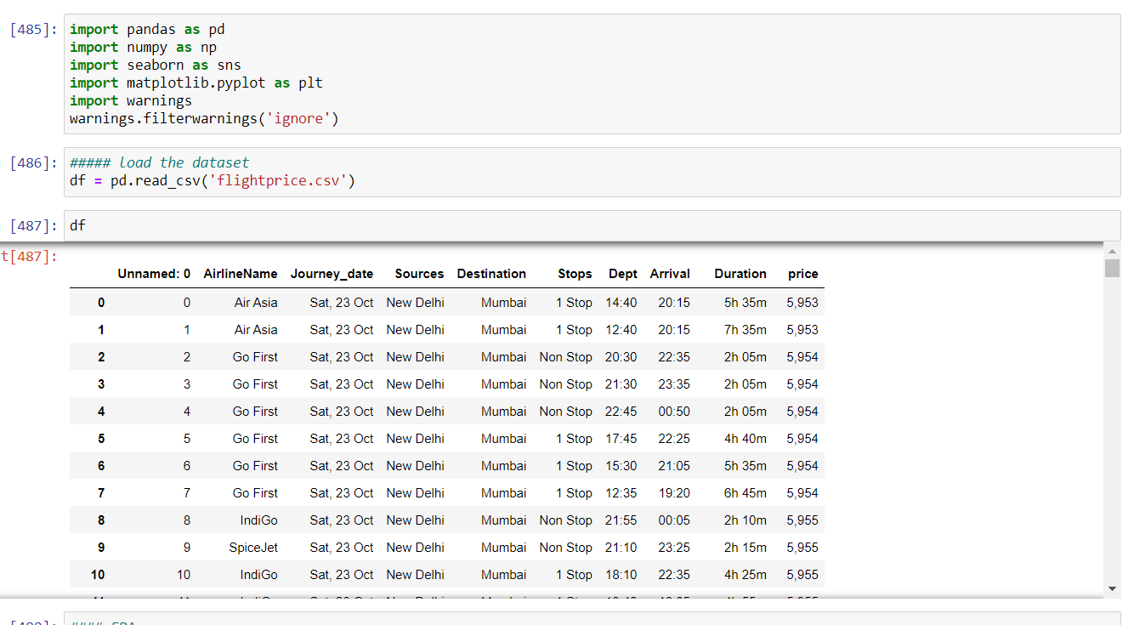
Flight Prediction – Load Dataset

Slide 7
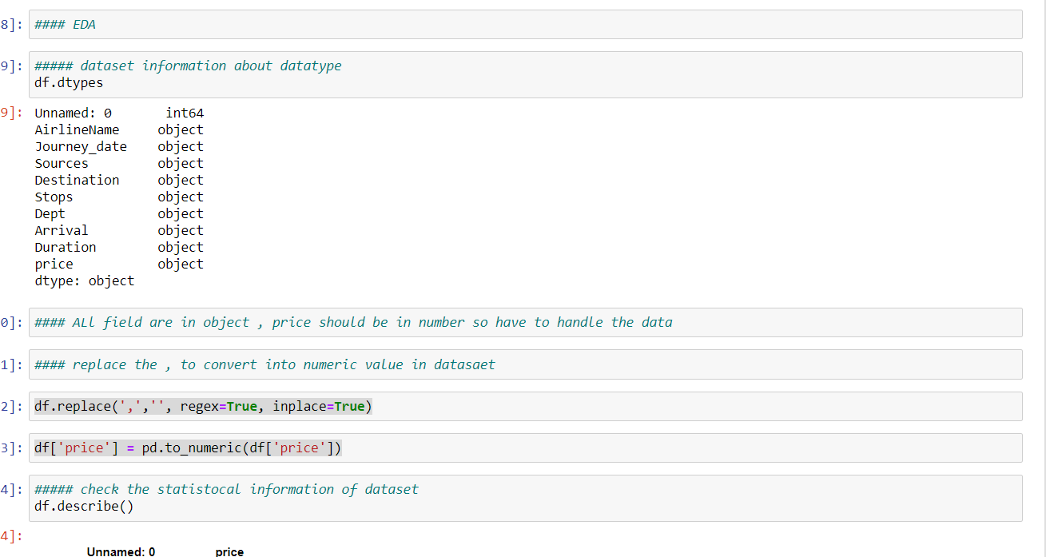
EDA – It is technique to know what is in my data how the data is behaving as per domain. Through EDA I know the shape size and description of data set.

Slide 8
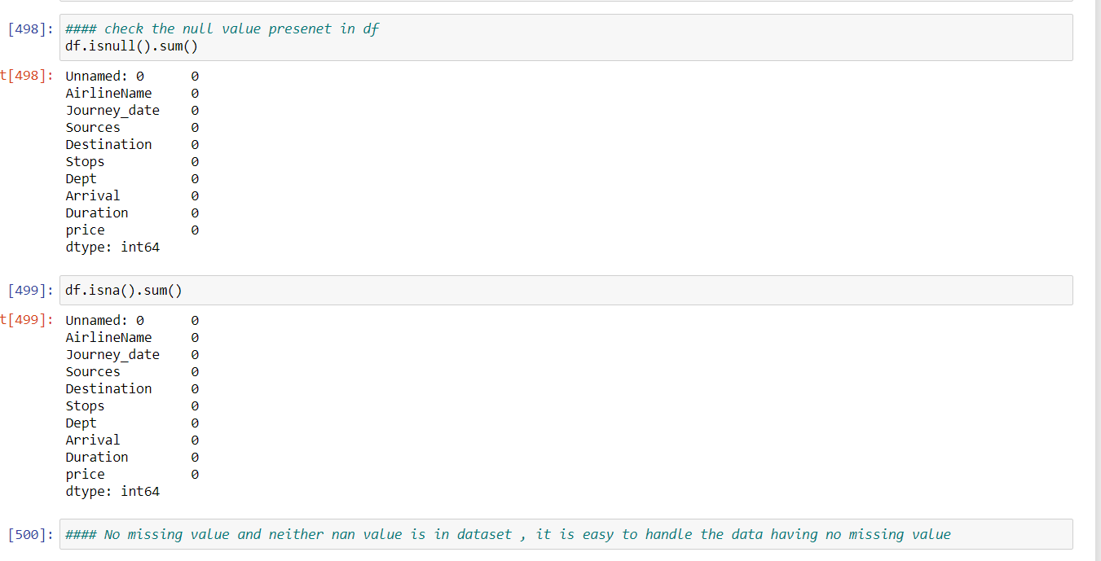
Check for Null Value

Slide 9
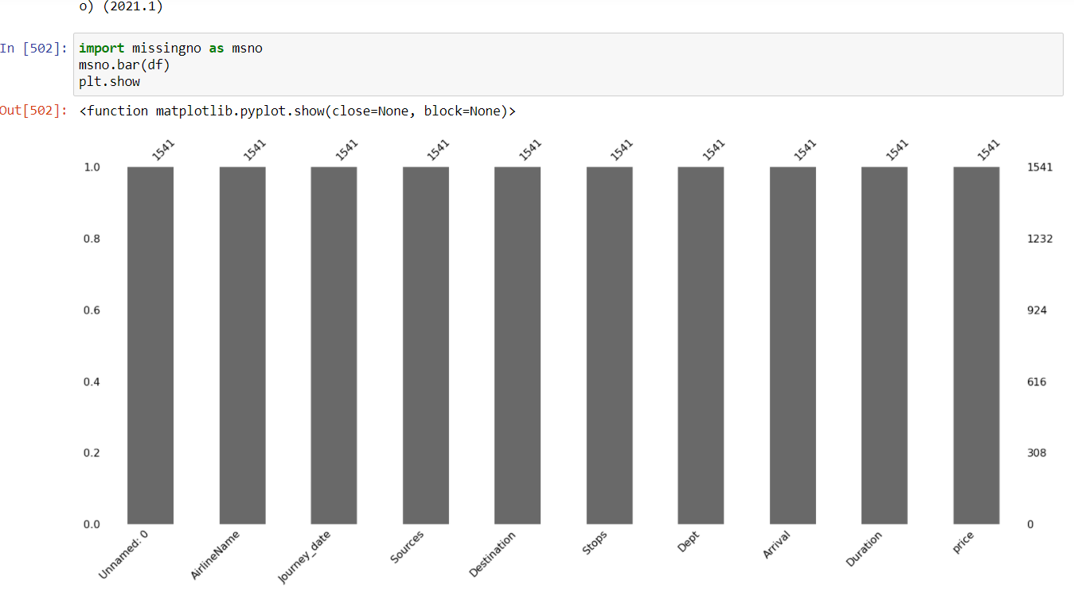
Visualization – It is process of showing data in chart format which make easy to know the data information in graphical representation.

Slide 10
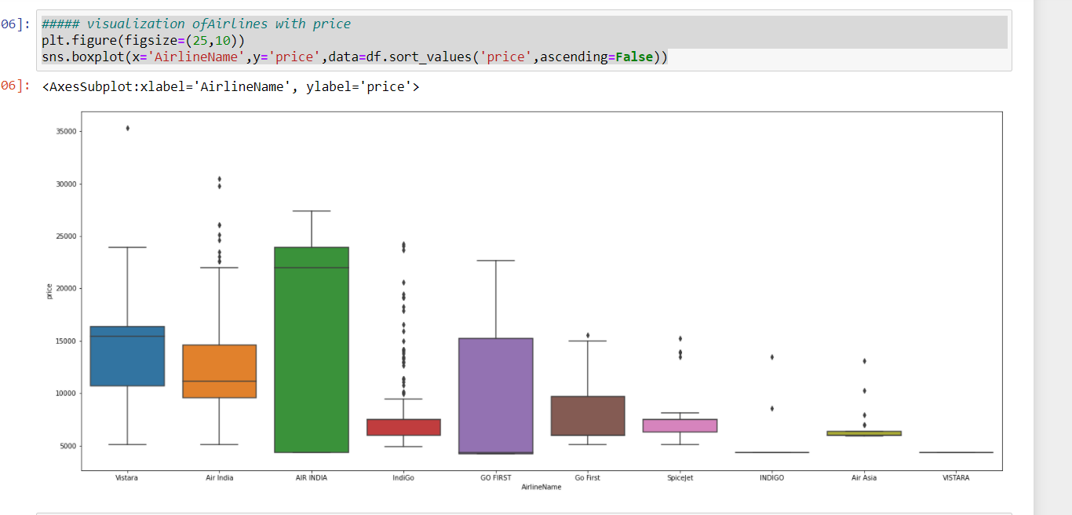
Price Vary with Airlines

Slide 11
Pre-Processing and Data Cleaning
It is the most important part of ML.
Data cleaning decide the Accuracy of Model.
Most of the time spent to cleaning of data.
I have used various techniques and it comes when we can see and judge each field and its use.

Slide 12
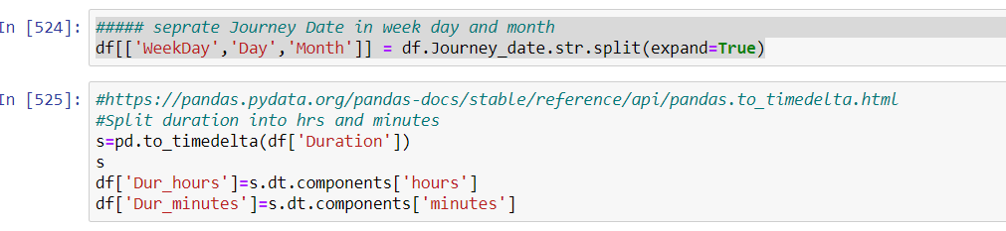
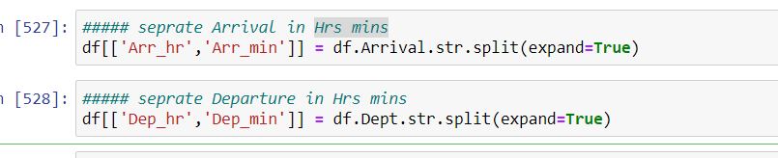
Here I have split the Journey Date into Day week and Month and same for min and Hrs

Slide 13
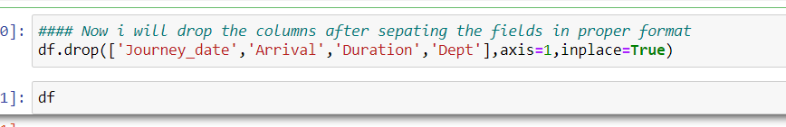
Drop the columns after splitting of Data

Slide 14
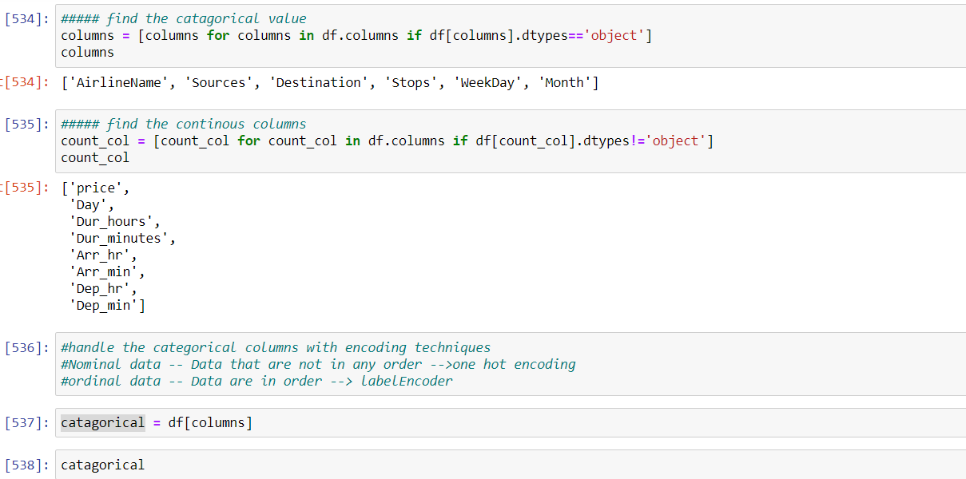
Separate Categorical And Continous Columns

Slide 15
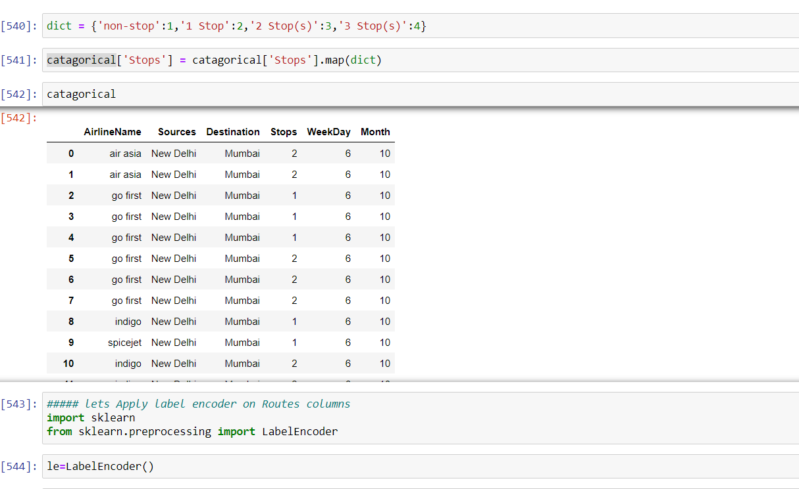
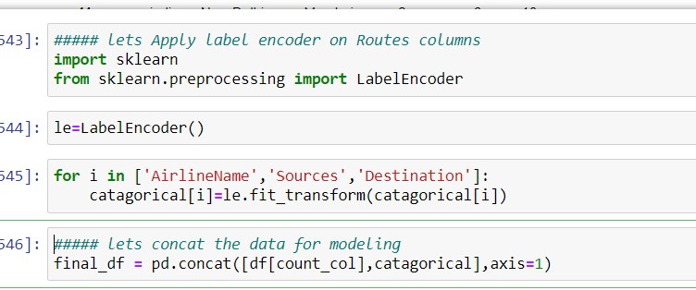
Encoding of columns

Slide 16
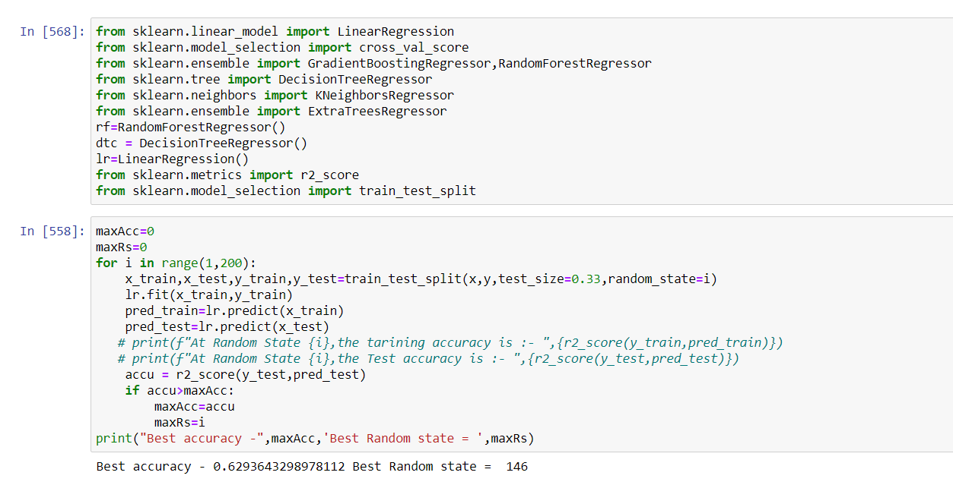
Model Building and Find the Best Random State

Slide 17
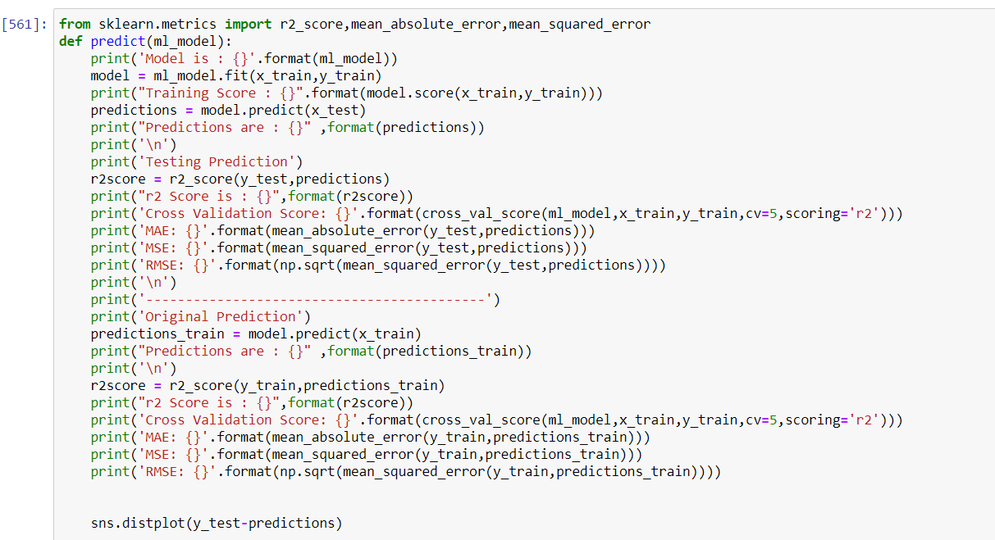
Function to Predict The Model

Slide 18
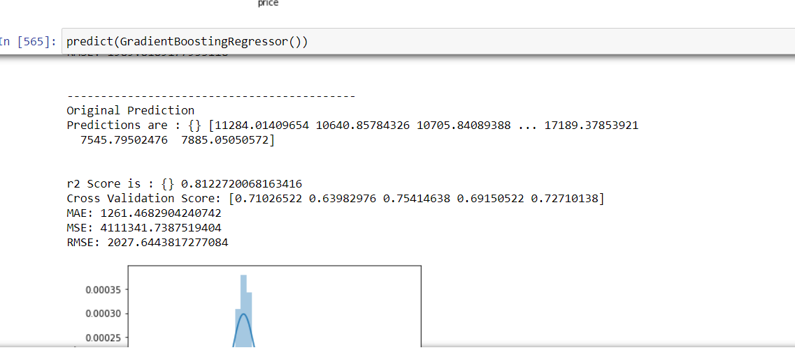
Gradient Bosting -Technique

Slide 19
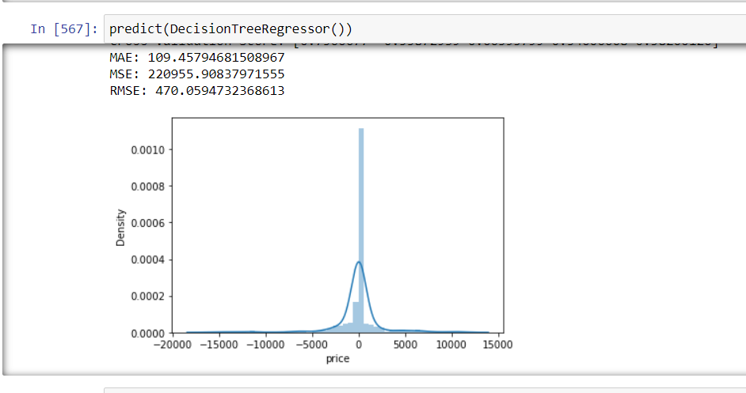
Decision Tree Method

Slide 20
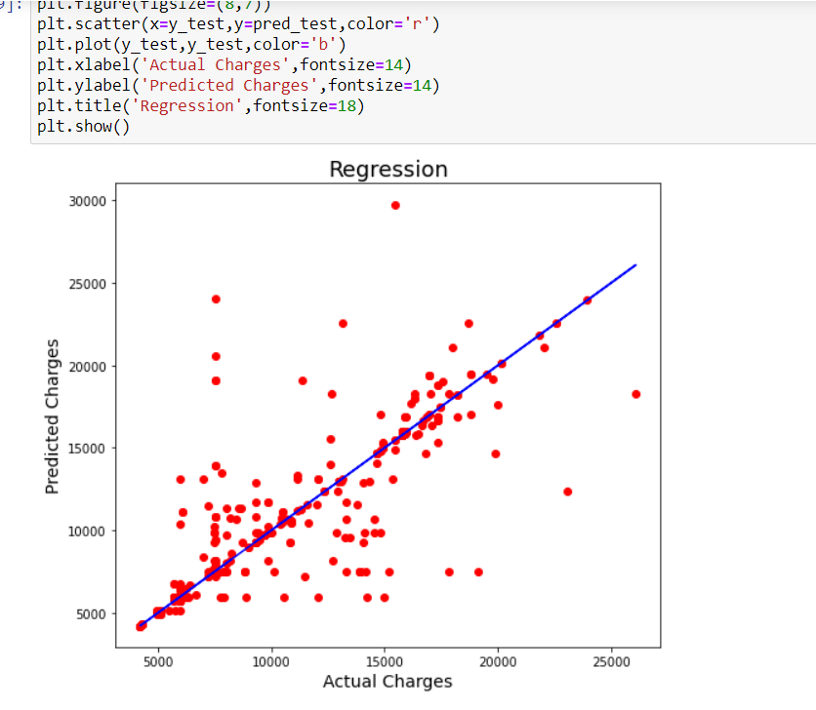
Best Fit Line

Slide 21
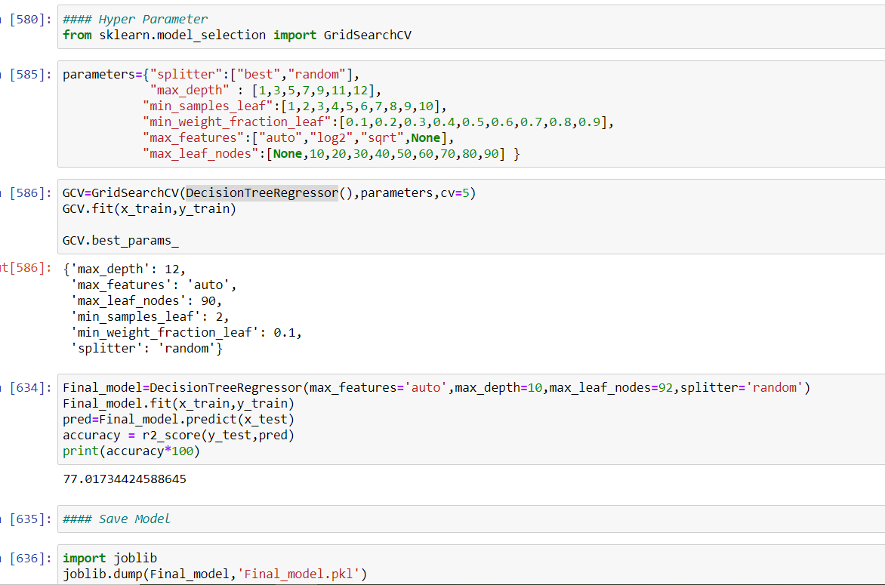
Tunning of Model – Hyper Parameter Tunning

Slide 22
Thank You

